Slide 1
Raymer Elementary
September 20, 2016

Slide 2
Welcome Ashley Fricke
Mental Health worker from ARC
Working at RAYMER Mondays
and Wednesdays
Contracted by the District
Can connect families with outside agencies

Slide 3
Thank you!
The sound system works great!!
Dream Big…
Projector to mount to ceiling – Points West coming
Staff to narrow the list

Slide 4
Enrollment
Today = 240
Projected at 246
10 divisions
K, K/1, ½, 2, 2/3, 3, 4/5, 4/5, 5/6, 5/6
Increase enrollment in the District 21 837 to 22 222
385 more students in district
569 since last year
Class added at North Glenmore, AME, Oyama, RVE, SVE, CTE

Slide 5
Critical Challenge
What is the heart of Raymer?
In others words, what makes Raymer so special?
Grow our strengths

Slide 6
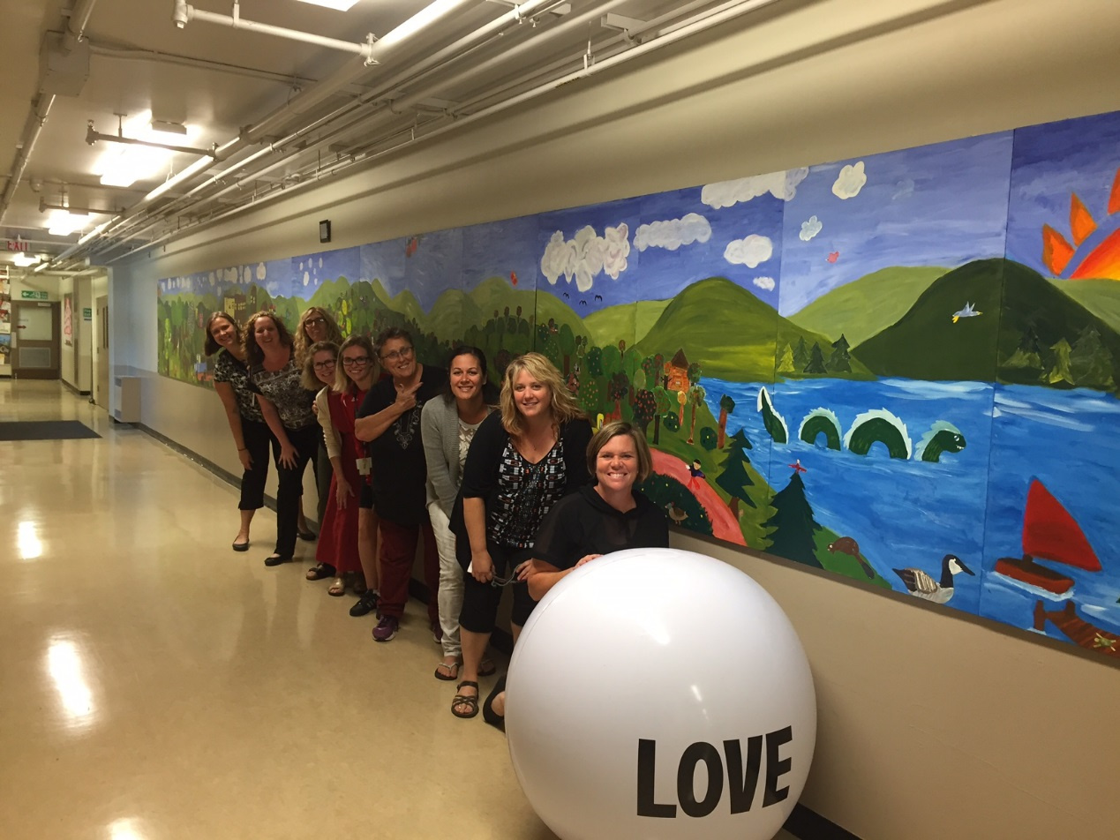
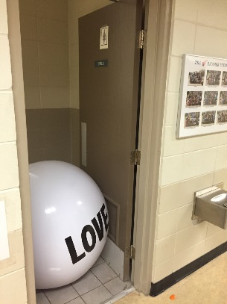
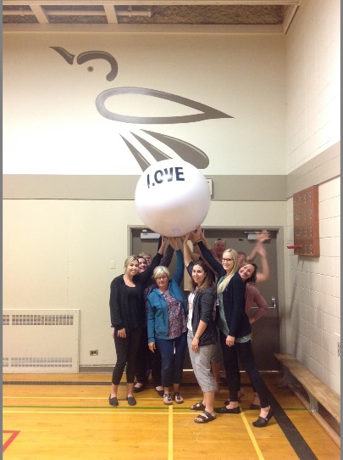
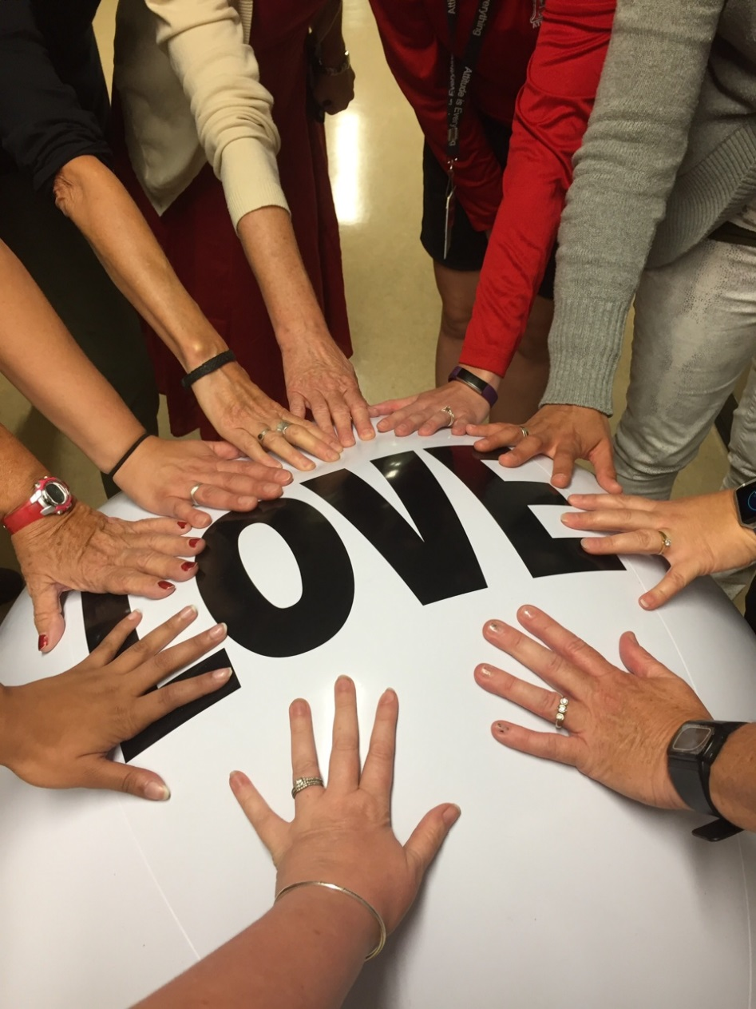
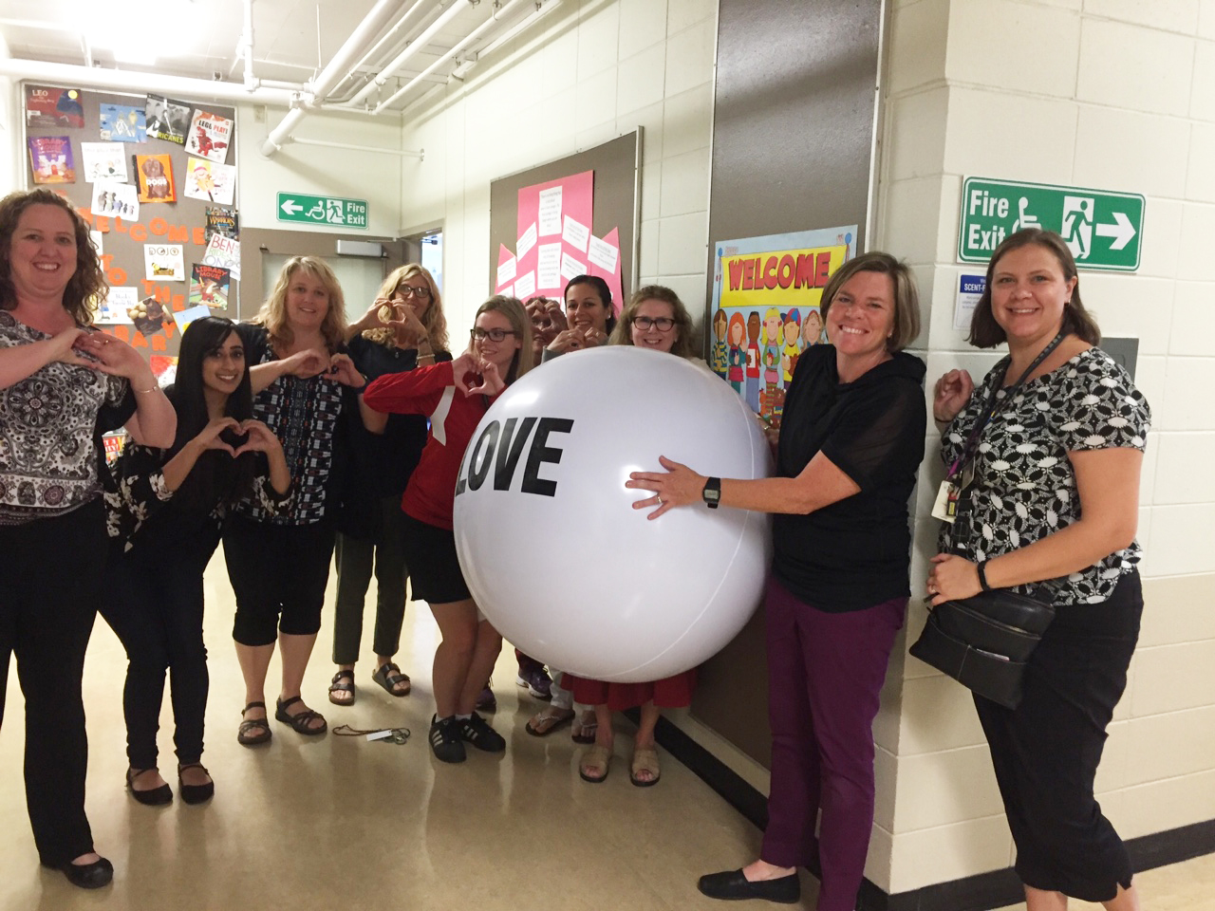

Slide 7
School Goals
Goal 1- To develop skills of self-awareness and self-regulation in order to promote students' ability to assume responsibility for emotional health.
Zones of Regulations
Friends Program
Common Language

Slide 8
Goal 2
90% of students will Meet/Exceed grade level expectations in Numeracy and Literacy.
Mrs. Nickle – literacy intervention Primary students
Mrs. Daum, Mr. Corrado and Mrs. Neufeld
First time an Intermediate Informational Meeting
Homework Club continuing

Slide 9
Goal 3
To continue to develop our students as Thinkers, Learners, Collaborators, Contributors and Innovators.
Continuing with Learning in Depth
Adding Grade 3 students this year

Slide 10
Communication
Newsletter – feedback
Ways to reach more parents
Noon Hour Supervisors needed to spare
Online system for signing up for parent-teacher conferences
Role of Board – pamphlets coming out
September 30 Orange Shirt Day

Slide 11
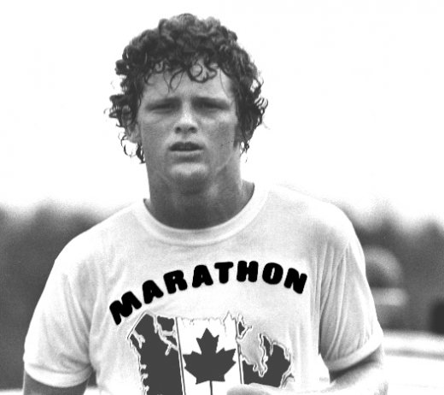
Terry Fox Run Sept 30
10:10-11:00 in the Back Field
Toonies for Terry

Slide 12
Student Leadership
Working on it…
Creative Ways to provide collaborative planning
Other grade 5s will have the opportunity as well

Slide 13
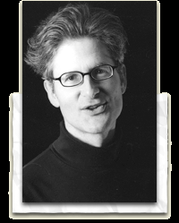
Visiting Author
Request for $500
Richard Scrimger
2 presentations:
1 primary and 1 intermediate

