Slide 1
PRESENTATION TO
COPAC CONFERENCE
AUTHENTIC PARENT ENGAGEMENT
Kevin Kaardal
Superintendent of Schools/CEO
Central Okanagan Public Schools

Slide 2

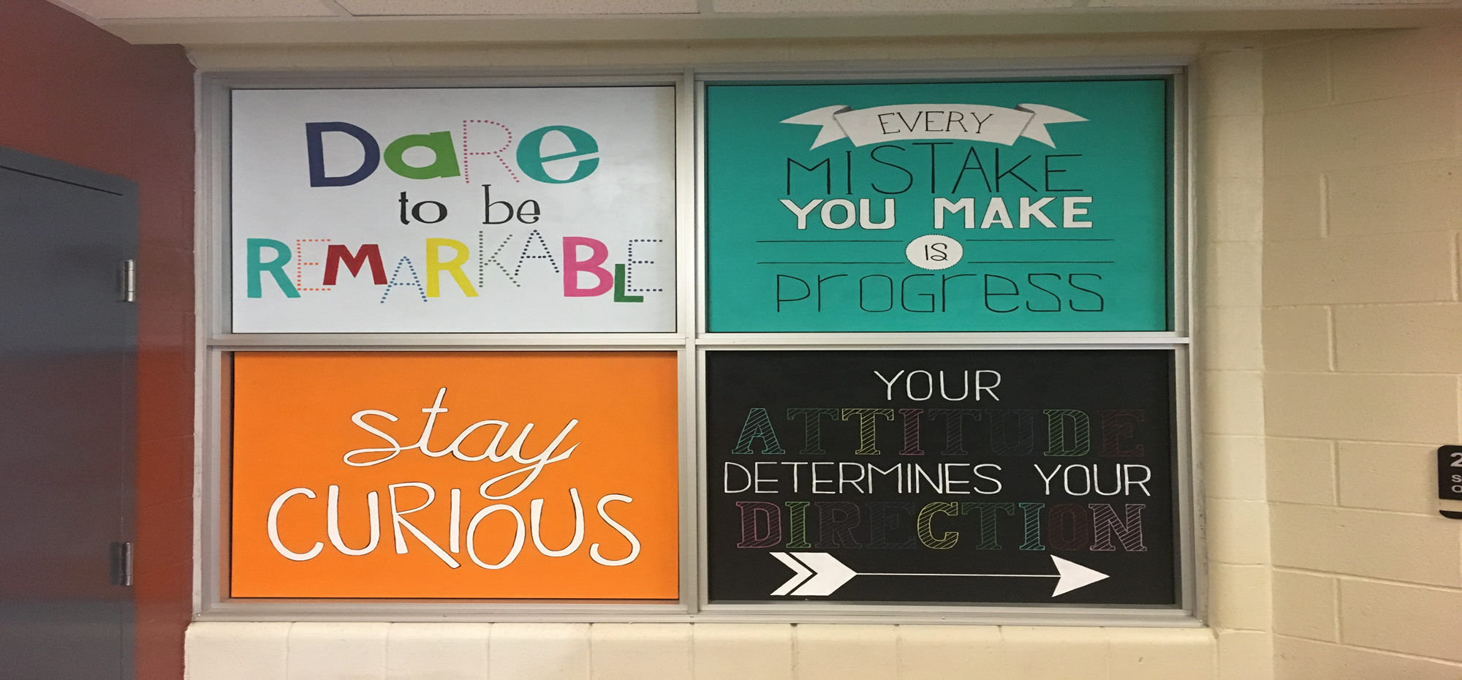
AUTHENTIC PARENT ENGAGEMENT

Slide 3

Ministry of Education
OUR PURPOSE
Notes:
Kevin
- Enhancing Student Learning

Slide 4
OUR PURPOSE
Board of Education
Our Mission:
To educate students in a safe, inspirational learning environment where each student develops the knowledge and skills to be a lifelong learner and healthy productive member of our global society.
Vision Statement:
Central Okanagan Public Schools is a progressive leader in education, which sets the standard for educational excellence and strives to ensure that each student has opportunities to succeed.
Notes:
Kevin
The next 4 slides are the work of the Board
Some involve community consultation and some are affirmations of the work we are doing

Slide 5

OUR PURPOSE
Board of Education
Our Overarching Goal:
"Each Central Okanagan Public School student (K-12) will provide evidence of being a learner, thinker, innovator, collaborator, and contributor."
Notes:
Kevin

Slide 6
Connecting…..
Competencies and Attributes
MINISTRY CORE
COMPETENCIES
Communication
Thinking
Personal and Social
ATTRIBUTES OF
A LEARNER
Learner
Thinker
Innovator
Collaborator
Contributor

Slide 7

Notes:
Vianne Kintzinger

Slide 8

PARENT ENGAGEMENT IN
DISTRICT POLICY
Policy 703 – Relations with Parents of Students
Policy 704 – Parent Advisory Councils (PAC)
Policy 705 – District Parent Advisory Council (COPAC)
Notes:
Kevin
The next 4 slides are the work of the Board
Some involve community consultation and some are affirmations of the work we are doing

Slide 9
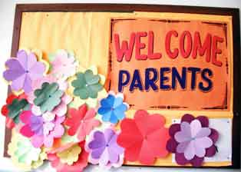
HOW ARE PARENTS ENGAGED
AT YOUR SCHOOL?
Parent and Teacher
Parent and Principal/Vice Principal
Events Spectator
Volunteer for Coaching/Events Organization or Field Studies Supervision
The Parent Advisory Council
  Committees at the School
  Enhancing Student Learning Planning
Fundraising
Discretionary Budget
Notes:
Kevin
The next 4 slides are the work of the Board
Some involve community consultation and some are affirmations of the work we are doing

Slide 10

STAND UP, TURN AND SHARE …

Slide 11
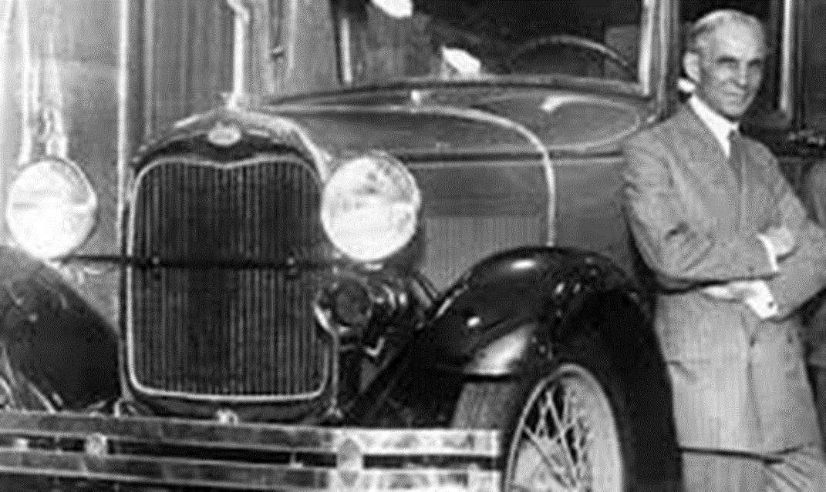
WHY IS INFLUENCING IMPORTANT?
“If there is one secret of success, it lies in the ability to get the other person’s point of view and see things from his [or her] angle as well as from your own” .
Henry Ford
Notes:
Kevin
The next 4 slides are the work of the Board
Some involve community consultation and some are affirmations of the work we are doing

Slide 12
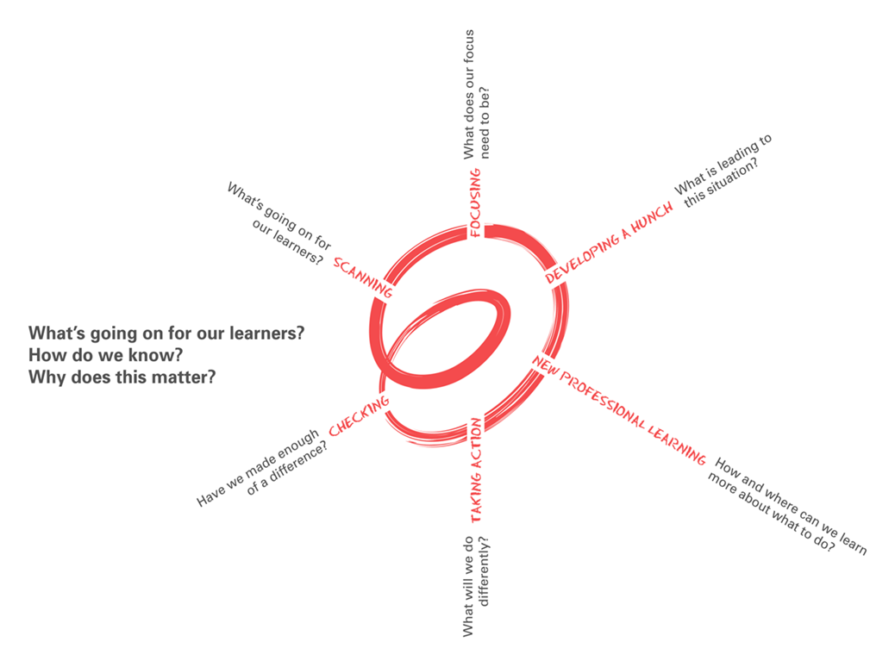
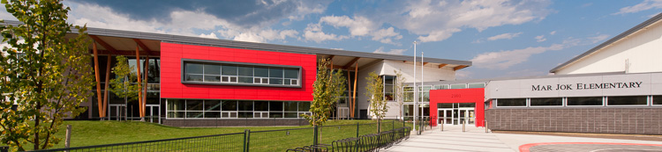
ENHANCING STUDENT LEARNING
Parents Have an Important Role
Enhancing Student Learning Process
  - School Community Learning Plans
  School Community Forums
  School Community Conversations/Visits
Notes:
Kevin
Describe process
Click on the picture of Mar Jok to link to their website and Learning Plan
You will be scheduled for School Community Conversations and visits
Go on line
More at the Education Focused Trustee Orientation
Handout – Schedule of School Conversations/Visits
Superintendent’s Report on Achievement

Slide 13
SCANNING AND HUNCHING
Notes:
Kevin
The next 4 slides are the work of the Board
Some involve community consultation and some are affirmations of the work we are doing

Slide 14
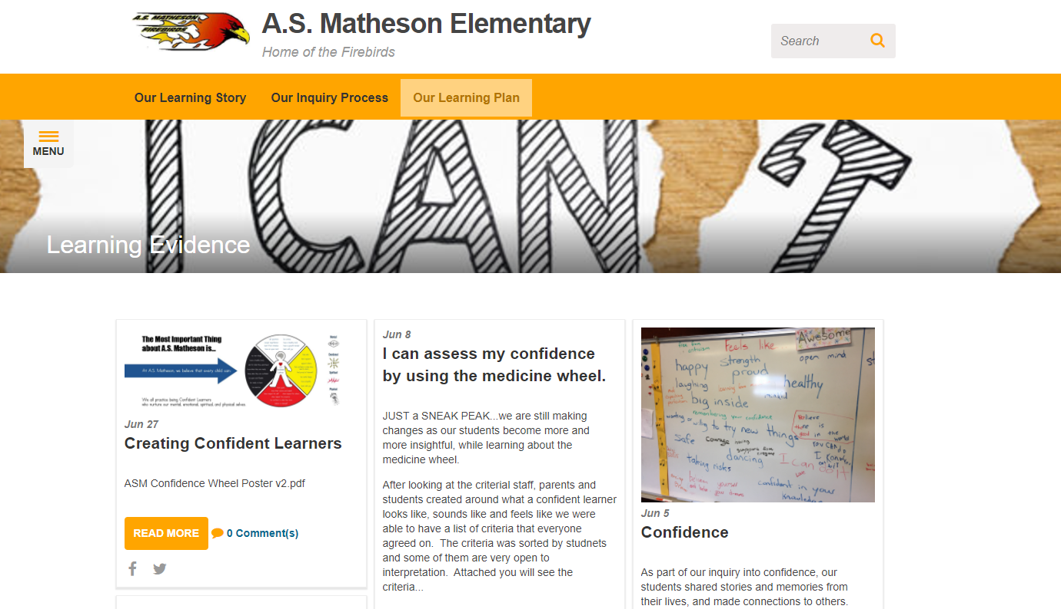

ENHANCING STUDENT LEARNING

Slide 15

ADMINISTRATIVE PROCEDURE
School and District Enhancing Student Learning Requirements
Notes:
Kevin
The next 4 slides are the work of the Board
Some involve community consultation and some are affirmations of the work we are doing

Slide 16

HOW IS YOUR PAC ENGAGED IN THE
SCHOOL COMMUNITY LEARNING PLAN?
Notes:
Kevin
The next 4 slides are the work of the Board
Some involve community consultation and some are affirmations of the work we are doing

Slide 17
STAND UP, TURN AND SHARE …

Slide 18

AT THE DISTRICT - COPAC
Attend Board of Education Meetings or read Agendas and Minutes
COPAC Representative
Board Committee Representative
  General Affairs Committee
  Education and Student Services Committee
  Finance and Audit Committee
  Planning and Facilities Committee
  Policy Committee
Notes:
Kevin
The next 4 slides are the work of the Board
Some involve community consultation and some are affirmations of the work we are doing

Slide 19
AT THE DISTRICT - COPAC
  District Committee Representative
  Aboriginal Education Council
  Public Education Awareness Committee
  Safe Schools Committee
  Health Promoting Schools Committee
  Human Rights Committee
  Early Years Partnership Committee
Notes:
Kevin
The next 4 slides are the work of the Board
Some involve community consultation and some are affirmations of the work we are doing

Slide 20

PROVINCIALLY
BCCPAC http//bccpac.bc.ca
Advocacy
Notes:
Kevin
The next 4 slides are the work of the Board
Some involve community consultation and some are affirmations of the work we are doing

